Slide 1


Introduction to
Robotic Process Automation
AUTOMATIC
E-CERTIFICATE
GENERATOR BOT
Your Register No. - 2116220701026
Name – Anand S
Guide Name – Mrs. J. Jinu Sophia, Assistant Professor (SG)
Designation and Department – B.E, Computer Science and Engineering

Slide 2
Abstract
The Automated E-Certificate Generation Bot leverages UiPath RPA to streamline and simplify the creation of personalized certificates. By integrating Excel for data sourcing and PowerPoint for template-based customization, the bot ensures efficiency, accuracy, and scalability. It automates data extraction, template preparation, and certificate generation, replacing manual processes prone to errors. This solution is ideal for academic and corporate events, offering uniformity and rapid processing for large-scale requirements. Future enhancements like AI-based design suggestions and cloud integration can further optimize and modernize the process.

Slide 3
Need for the Proposed System
Elimination of Manual Effort: Traditional certificate generation involves repetitive tasks that are time-consuming and prone to human errors. Automation significantly reduces manual intervention.
Efficiency in Large-Scale Operations: Handling bulk certificate creation for events or programs is challenging manually. The proposed system ensures rapid and seamless processing of large datasets.
Accuracy and Consistency: Automated processes ensure uniformity in formatting and prevent errors in recipient details, enhancing professionalism.
Scalability: As event sizes grow, the system can easily scale to manage increasing volumes without compromising quality or speed.
Cost-Effectiveness: Reduces labor hours and operational costs by automating repetitive tasks.
Future-Proofing: The system supports integration with AI, databases, and cloud storage, ensuring adaptability to future technological advancements.

Slide 4
Advantages of the Proposed System
Speed and Efficiency: Automates certificate creation, enabling rapid processing of large volumes compared to manual efforts.
Accuracy: Eliminates human errors in data entry and formatting, ensuring high-quality output.
Consistency: Maintains uniform design and formatting across all certificates, enhancing professionalism.
Scalability: Easily handles increasing workloads, making it suitable for events of any size.
Cost Savings: Reduces the need for manual labor, cutting operational costs and saving time.
Ease of Integration: Seamlessly integrates with Excel, PowerPoint, databases, and cloud platforms for smooth data handling and storage.
Customizability: Supports dynamic template use, allowing personalized certificates tailored to different needs.
Environmentally Friendly: Digital certificates reduce the need for paper-based certificates, promoting sustainability.
Future-Ready: Can incorporate AI and other advanced technologies for further automation and enhanced features.

Slide 5
Literature Survey
Existing Systems
Manual creation is time-consuming and error-prone for bulk tasks.
Custom software solutions lack flexibility and are costly for small-scale applications.
Relevant Studies
RPA reduces labor costs by 70% and improves delivery by 50%.
UiPath integrates with Excel and PowerPoint for efficient workflows.
Technology Insights
Enables dynamic placeholders and scalable, reusable templates.
Gap Analysis
Current systems are complex or lack dynamic capabilities, requiring a streamlined solution.
Proposed Solution
Combines UiPath RPA with Excel and PowerPoint for accuracy, scalability, and efficiency.

Slide 6
Main Objective
To develop an Automated E-Certificate Generation System using UiPath RPA that streamlines the process of creating personalized certificates by automating data extraction, template customization, and certificate generation. The system aims to enhance efficiency, accuracy, and scalability, making it suitable for handling bulk operations with minimal manual intervention.

Slide 7
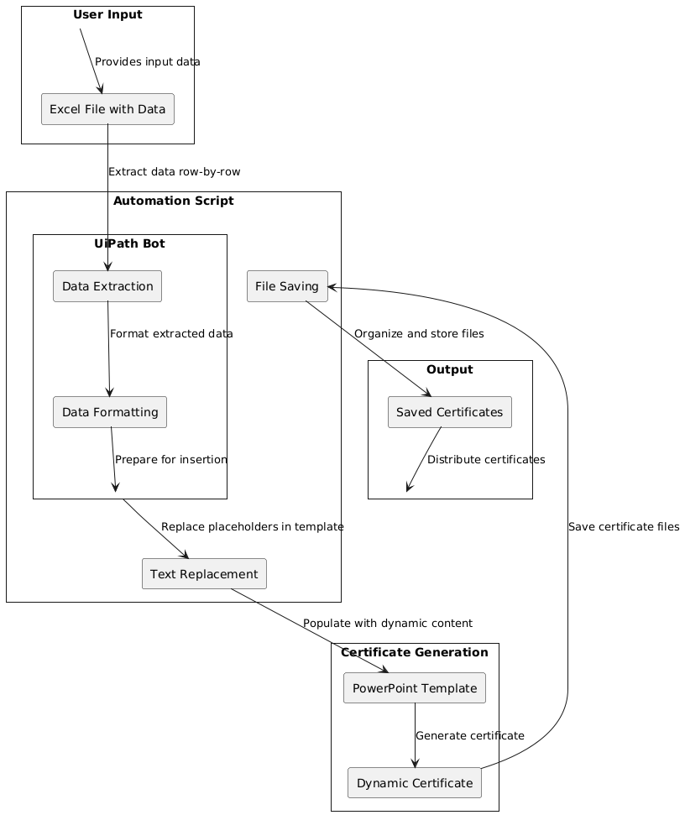
Architecture

Slide 8
System Requirements
1. Hardware Requirements:
Processor: Intel Core i3 or higher (recommended: i5 or above)
RAM: Minimum 4 GB (recommended: 8 GB or higher for efficient processing)
Storage:
  500 MB free disk space for the RPA tool installation.
  Additional space for storing Excel files, templates, and generated certificates (depending on volume).
  Display: Minimum 1024x768 resolution.

Slide 9
System Requirements
2. Software Requirements:
Operating System:
Windows 10 or above.
Development and Automation Tools:
UiPath Studio:
  For creating and executing the automation script.
  License may vary (Community or Enterprise edition based on the organization).
Microsoft Office Suite:
  Excel: For recipient data input and management.
  PowerPoint: For certificate template creation and editing.
PDF Viewer (optional):
  To view and verify generated certificates if exported as PDF.

Slide 10
Functional Description
Input Handling:
  Reads recipient data from Excel.
  Uses a PowerPoint template with placeholders.
Certificate Creation:
  Replaces placeholders with recipient details.
  Generates consistent certificates dynamically.
Automation Process:
  Iterates through Excel rows.
  Ensures accuracy with error handling.
Output Storage:
  Saves certificates with unique filenames.
  Organizes files for easy access.
Scalability:
  Processes large datasets efficiently.
Result: Rapid, error-free, and scalable e-certificate generation.

Slide 11
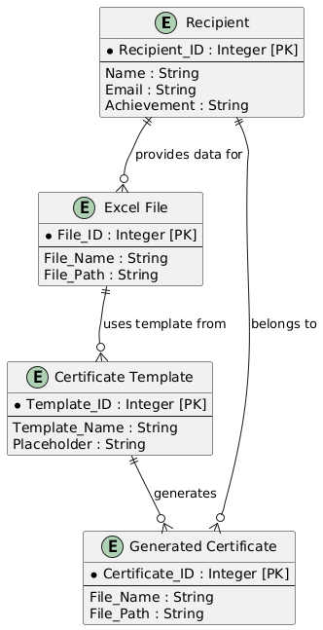
Table Design

Slide 12
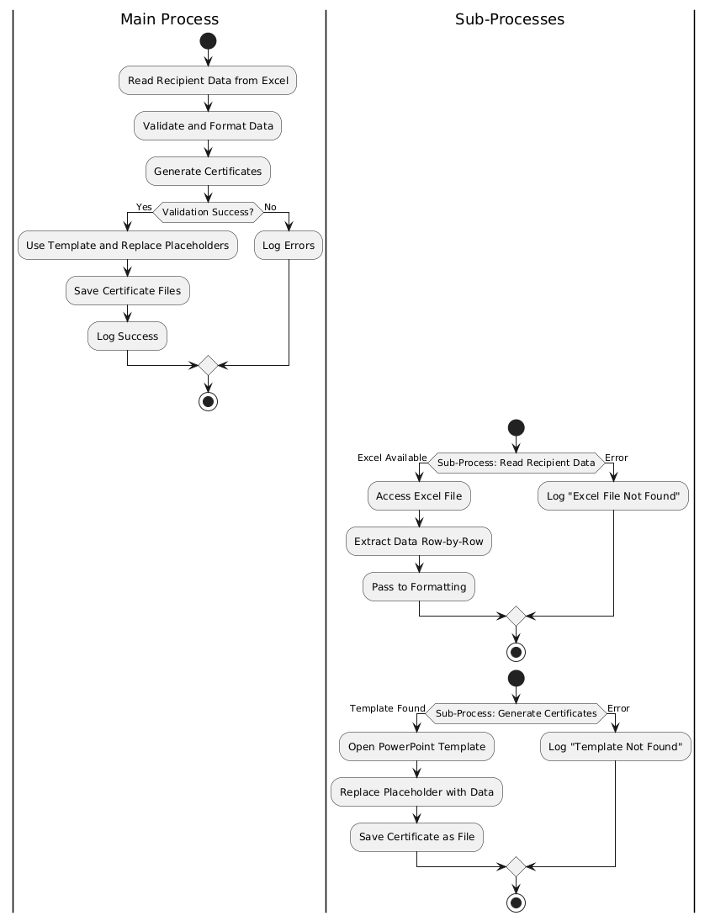
Process Design
Main Process:
Starts with reading recipient data and validating it.
If the data is valid, it uses the template to generate certificates and save them.
If errors occur during validation, they are logged.
Sub-Processes:
Reading Data: Reads data from the Excel file row-by-row. If the file is missing, it logs an error.
Generating Certificates: Replaces placeholders in the template with dynamic content and saves the certificate. Logs an error if the template is missing.

Slide 13
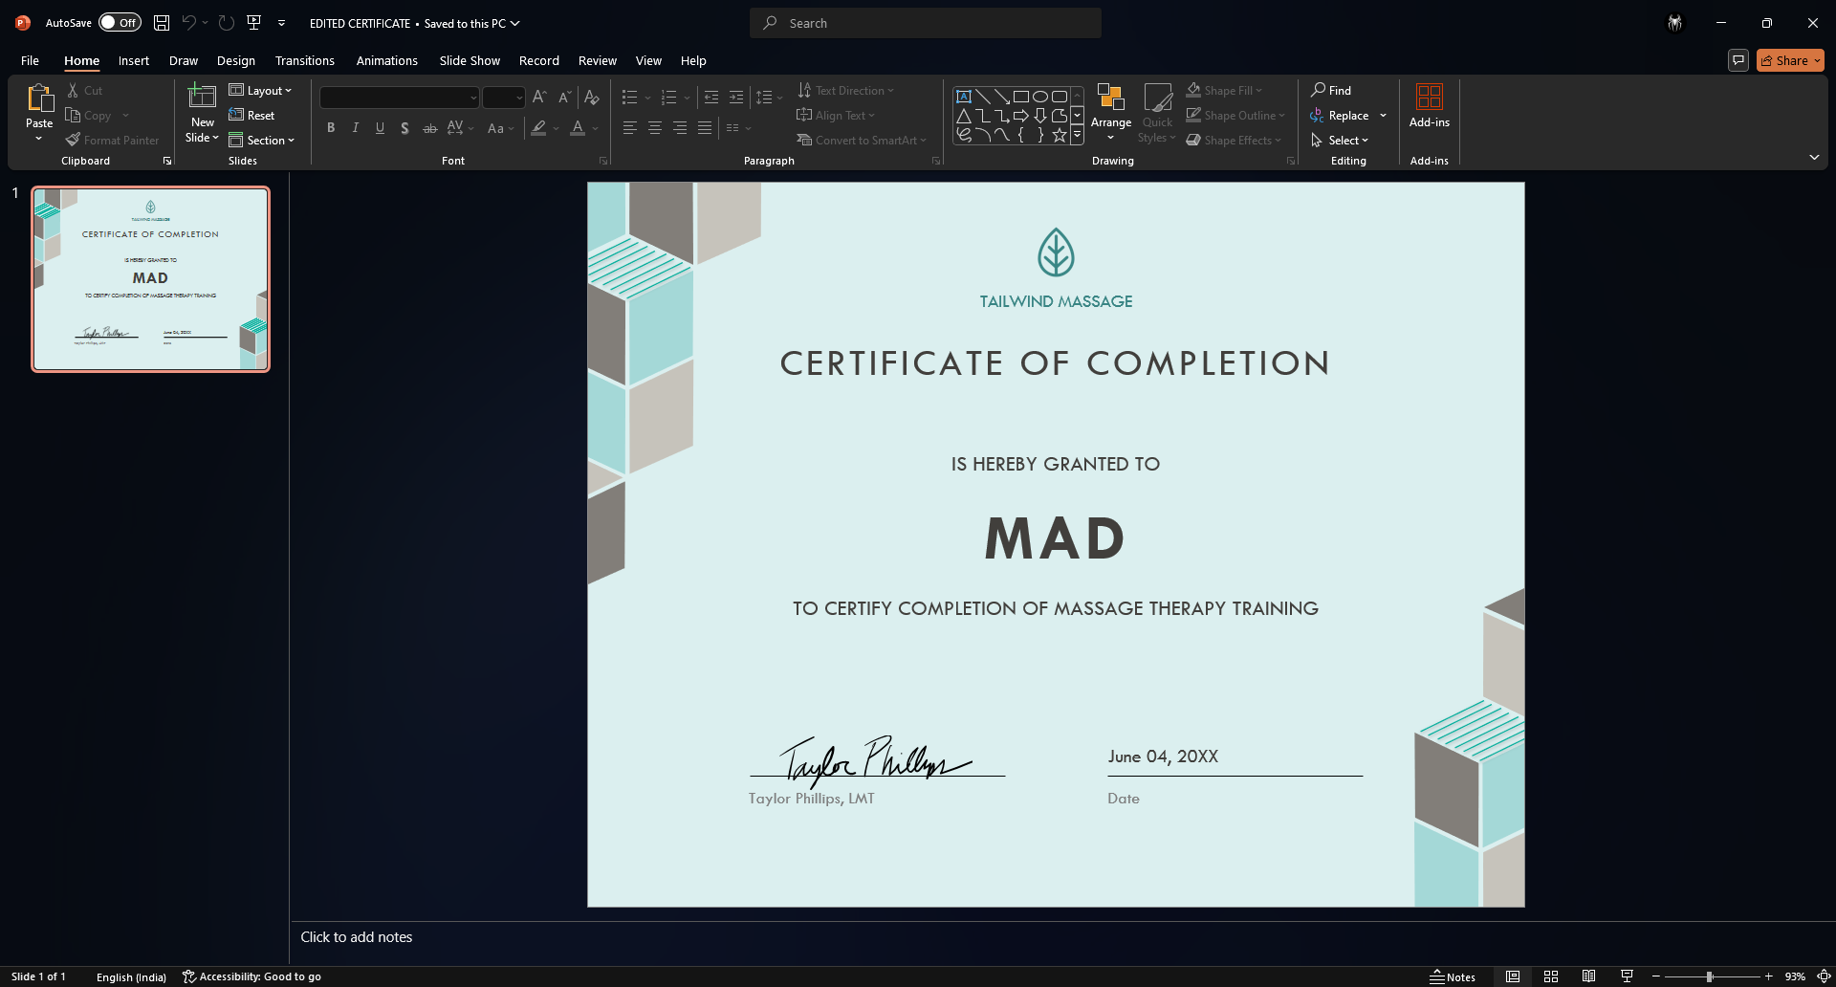
Implementation
CERTIFICATE TEMPLATE

Slide 14

Implementation
EXCEL WITH NAME LIST

Slide 15
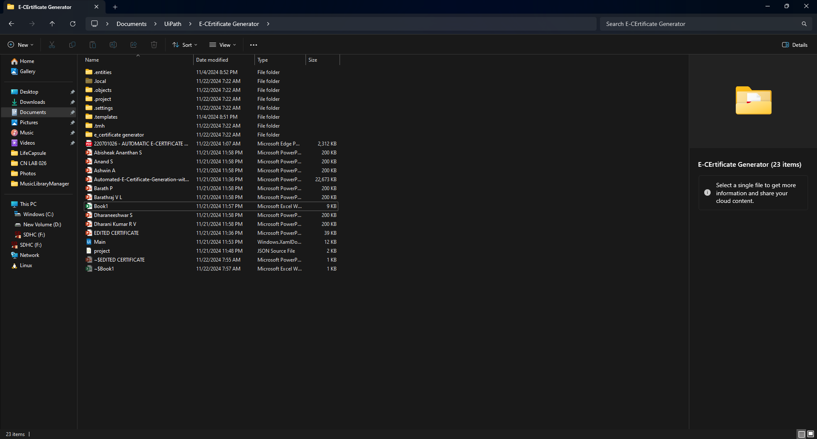
Implementation
THE PREPARED CERTIFICATES

Slide 16
Conclusions
The Automatic E-Certificate Generation Bot streamlines and automates the process of generating personalized e-certificates, offering:
Efficiency: Rapid and error-free certificate creation.
Scalability: Handles large datasets with ease.
Consistency: Ensures uniform formatting across certificates.
Versatility: Adapts to various events and use cases.
By leveraging UiPath RPA, the project eliminates manual effort, reduces errors, and enhances productivity, making it a reliable solution for large-scale certificate management.

Slide 17
Future Enhancement
Database Integration:
Fetch recipient data dynamically from a database for real-time processing.
Email Automation:
Automatically email certificates to recipients after generation.
AI Design Suggestions:
Integrate AI to recommend certificate designs based on event type.
Cloud Integration:
Save and share certificates via platforms like Google Drive or OneDrive.
Multi-Language Support:
Generate certificates in multiple languages for global events.
Mobile App Integration:
Enable certificate downloads through a dedicated app.

Slide 18
IEEE Paper
Enhancing Workflow Automation Using RPA: A Case Study
This paper discusses the application of Robotic Process Automation (RPA) to improve efficiency by automating repetitive tasks. It emphasizes scaling RPA solutions across different processes, which is directly related to automating the certificate generation process in your project​
.
Intelligent Process Automation: Bridging Legacy and Modern Systems
This paper highlights how RPA tools can integrate with legacy systems and modern applications, offering a path to automating workflows that interact with various technologies like Microsoft Office. This would be beneficial for automating document generation (PowerPoint templates) and ensuring seamless workflows in your project​
.
AI-Augmented Document Automation for Streamlined Business Processes
This research focuses on using AI with RPA to process documents more intelligently, automating not just the tasks but also adapting the workflows based on document content. For your certificate generation bot, leveraging AI to suggest or adapt certificate designs dynamically could add a layer of flexibility and enhancement​
.

Slide 19
References
UiPath Documentation:
Official guide for building RPA workflows.
(uipath.com)
Microsoft Office Suite:
PowerPoint and Excel integration for dynamic certificate creation.
(microsoft.com)
PlantUML Documentation:
For diagram generation and process modeling.
(plantuml.com)
RPA Blogs and Tutorials:
Insights into automating repetitive tasks and error handling.
Online Forums:
Discussion platforms like Stack Overflow for resolving automation challenges.

Slide 20
Queries

Slide 21
Demonstration

